Slide 2
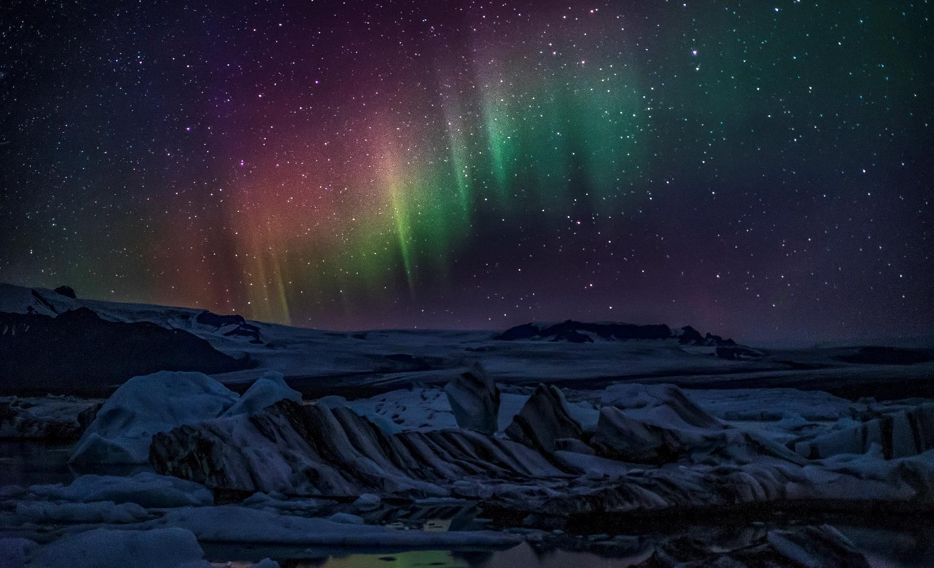
What is RELIGION?

Slide 3
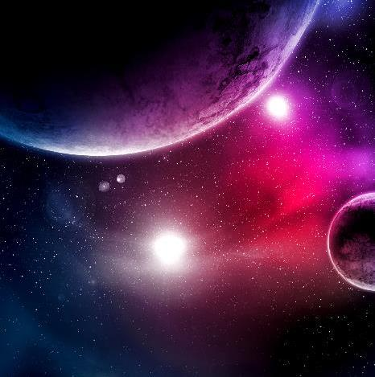
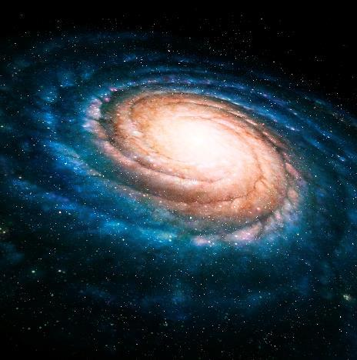
Defining Religion
"a set of beliefs concerning the cause, nature, and purpose of the universe . . ."
All religion has a set of beliefs about where the universe came from, what it is, and why it exists.
That's all that religion is.

Slide 4
Categorizing Religion
Humanistic: focuses on this earth and the physical, material aspects of existence as the basis of all reality
Deifies man: human beings are the highest beings in existence
Don’t focus on any authority higher than man

Slide 5
Categorizing Religion
Deistic: believes in the existence of something divine
Could be polytheistic or monotheistic
Believes in a higher authority
Consistent deist would bow to this higher authority

Slide 6
Which Is The True Religion?
True Religion is NOT:
Geocentric Religion - true religion does not use the earth or earthly life as the sole or even the primary basis of evaluating truth
Most people see purpose of “organized religion” is to improve human condition physically
“Any Port In A Storm” Religion – a means of coping with life’s difficulties
“As long as your religion gets you through the dark of the night.”
But TRUE RELIGION will then cause one to continue serving God after the storm has passed

Slide 7
Which Is The True Religion?
True Religion is NOT:
“Happy-Go-Lucky” Religion - unconcerned, carefree person
True Religion creates happy, joyful, fulfilled and content people
Many today entering religions for the fun they get out of it
“Make It Up As You Go Along” Religion - Acts 17:21
Paul exhorted them to seek the TRUE GOD – Acts 17:26,27
“Ear Tickling” Religion – Psalm 50:21

Slide 8
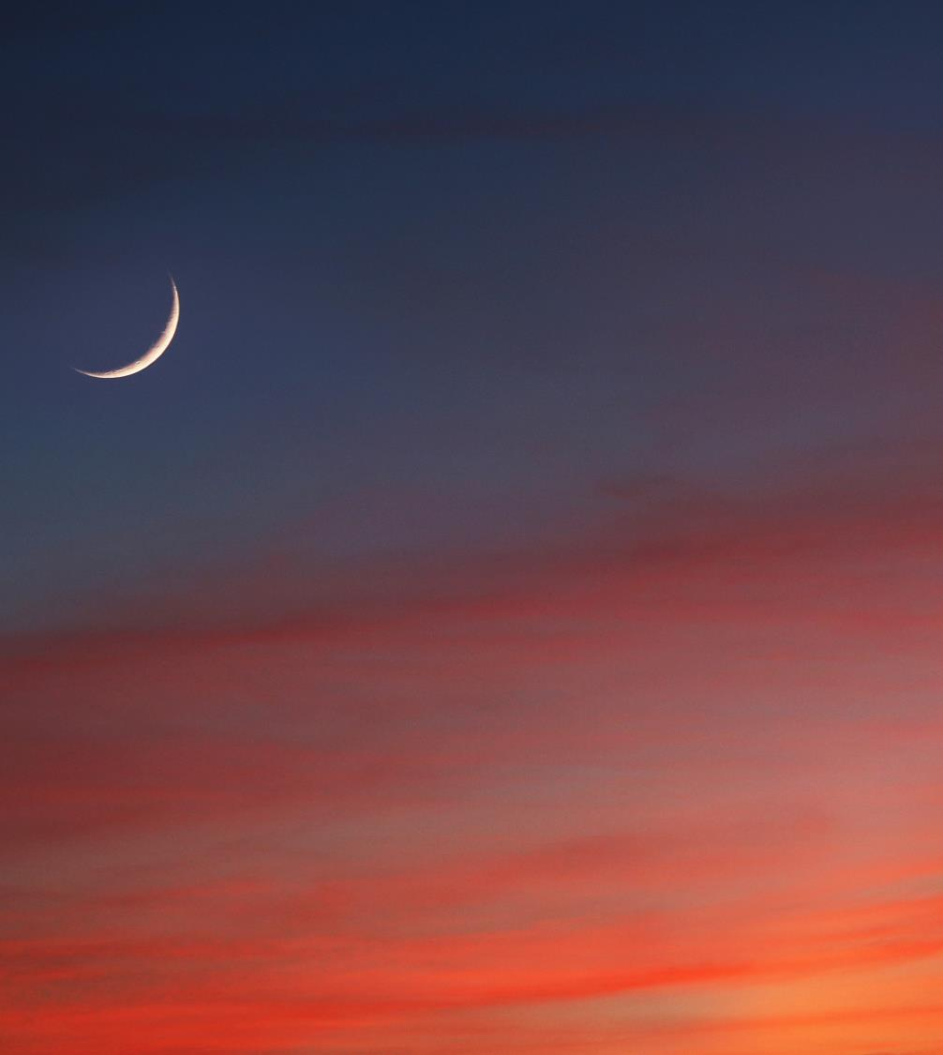
True Religion Is:

Slide 9
True Religion Is:
Seeking Truth - an objective process based on the mind's analysis of all the evidence we can look at.
Everyone seeking truth will discover atheism and polytheism are illogical
Seeking The True God – Acts 17:26,27
Finding God – accept God for Who He is
How you feel is unimportant
What you think God should be is irrelevant

Slide 10
True Religion Is:
Where Do We Find God? 2 Peter 1:20,21
He is readily available – Acts 17:27
Seeking The True God – Acts 17:26,27
Psalm 23
DOES NOT consist of “whatever gets you through the night”
But of SEEKING and FINDING GOD!

Slide 11
True Religion Is:
When you find God, you will find a loving, benevolent Creator Who cares for His children
Being Reconciled To God – Exodus 23:25
Only Christ can reconcile you to the Father- Colossians 1:16-20
Jesus Is The Only Way To Heaven – John 14:6

Slide 12

Everyone is RELIGIOUS-
But Few Follow TRUE RELIGION
Have you looked for the truth about religion?
Do you care enough about truth to seek it?
2 Corinthians 5:18-20
“BE RECONCILED TO GOD.”

